Slide 1





Twitter Sentiment Analysis
-By Jagruti Yewale

Slide 2
Objective-
The objects of Twitter sentiment analysis include tweets, metadata (timestamps, user profiles), sentiment labels, features (word frequency, emojis), machine learning models, lexicons, and visualizations. Through analyzing these objects, the sentiment towards topics, brands, or events can be understood. Objectives encompass understanding public opinion, brand monitoring, customer feedback analysis, market research, crisis detection, political analysis, and social listening, aiding in decision-making, reputation management, and customer engagement.

Slide 3
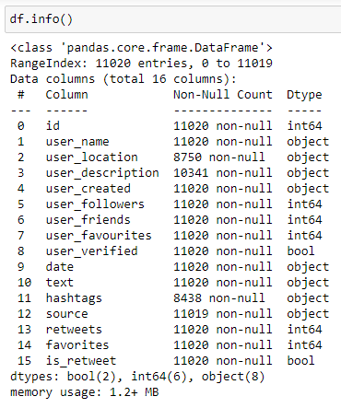
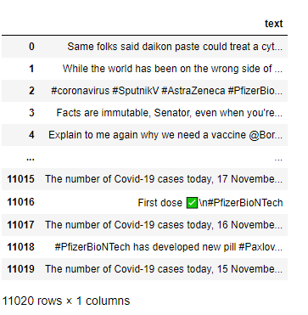
Importing and Data Loading-

Slide 4
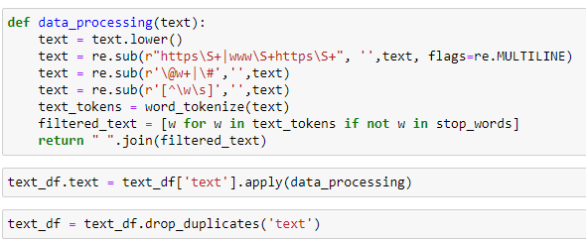
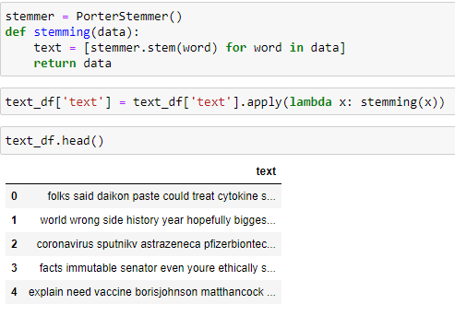
Data Processing-
Porter Stemmering

Slide 5
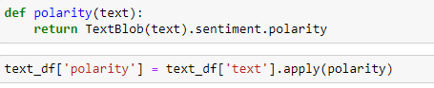
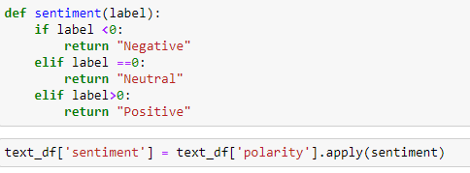
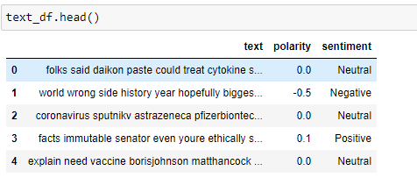
Polarity & Sentiment Analysis-
Polarity & Sentiment Analysis
02 - WEBSITE
03 - SOCIAL MEDIA

Slide 6
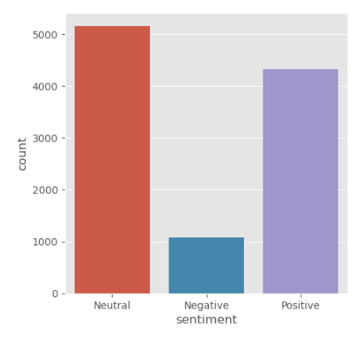
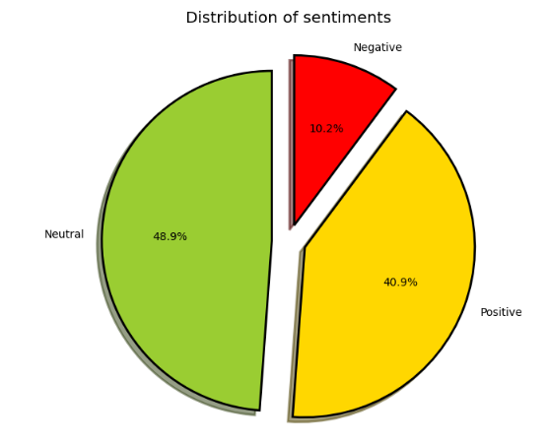
Visualization Analysis

Slide 7
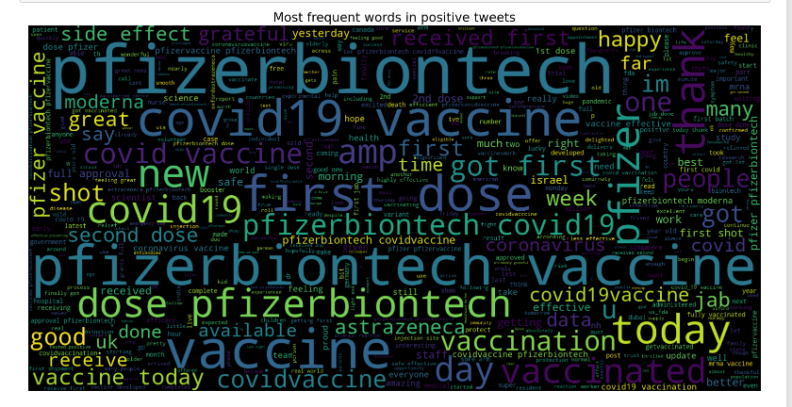
Word Cloud
Concept Of Word cloud-
Word clouds visually represent the frequency of words in a text, with larger words indicating higher frequency. They provide a quick and intuitive overview of the most common terms in a dataset, such as Twitter tweets. Word clouds are used for sentiment analysis, topic extraction, and content summarization. They help identify key themes, trends, and sentiments within large volumes of text, making it easier to understand and interpret the most prevalent topics or sentiments present.

Slide 8
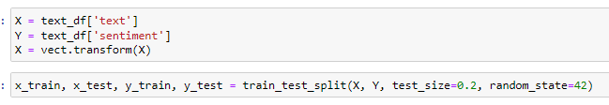
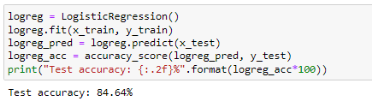
Training & Testing Data
Model Building
01 - BRANDING
03 - SOCIAL MEDIA

Slide 9
Future Application
Social Impact Assessment: Sentiment analysis can be used to assess the social impact of events, policies, or initiatives by analyzing public sentiment on social media platforms like Twitter, helping organizations measure and improve their social responsibility efforts.
Predictive Analytics: By analyzing historical sentiment data, machine learning algorithms can forecast future sentiment trends, enabling businesses to anticipate market shifts, customer behaviour changes, and emerging issues.
Real-time Market Intelligence: Businesses can use sentiment analysis to monitor market trends, consumer preferences, and competitor strategies in real-time, enabling agile decision-making and strategic planning.
Personalized Customer Experiences: By analyzing sentiment, companies can tailor their products, services, and marketing efforts to better meet the needs and preferences of individual customers, enhancing overall customer satisfaction and loyalty.

Slide 10
Conclusion
Twitter sentiment analysis offers valuable insights into public opinion, market trends, and societal dynamics. It enables proactive decision-making, enhances customer experiences, and aids crisis management. As technology evolves, its potential for innovation and strategic impact continues to grow, reshaping digital interactions and decision-making processes.

Slide 11
THANK YOU

